Slide 1


Radiologium

Slide 2
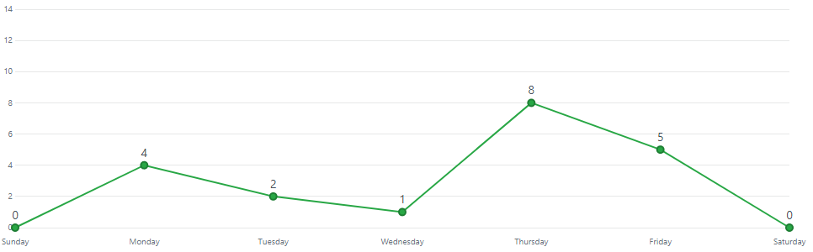

Slide 3
Radiologium

Slide 4
Problems Encountered
Game loop (scope)
Collision Detection
weapon aim

Slide 5
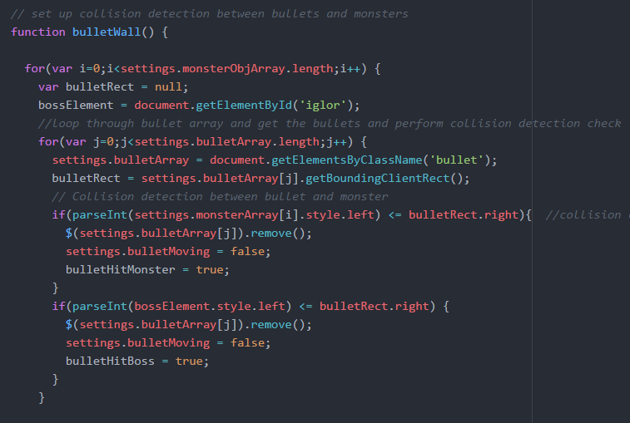
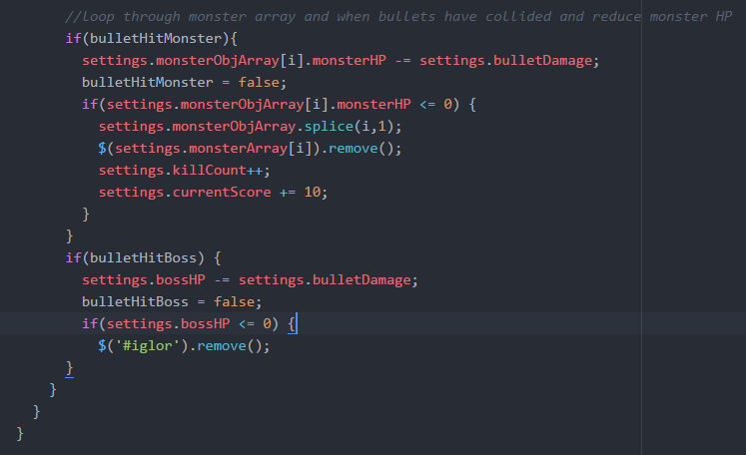

Slide 7
Go to radiologium site

